Slide 1

SSID: WWCode
Password: password
Notes:
Please remove this slide when sharing the document to the public

Slide 2
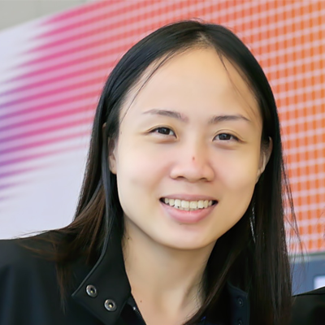
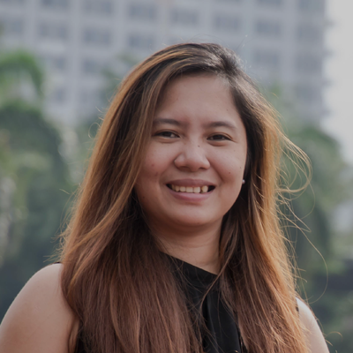
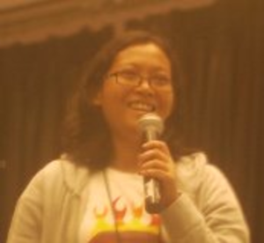
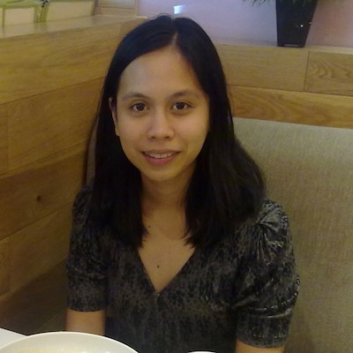
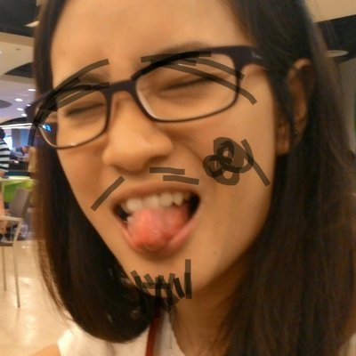
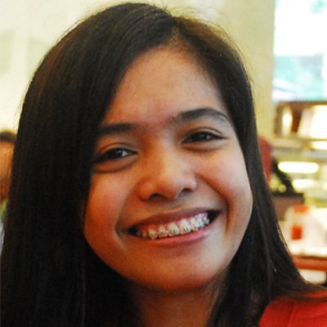

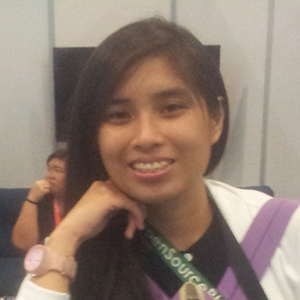
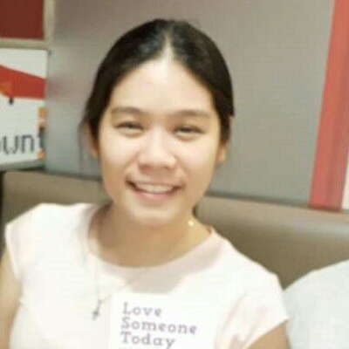
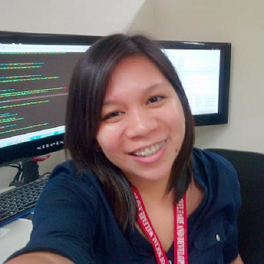
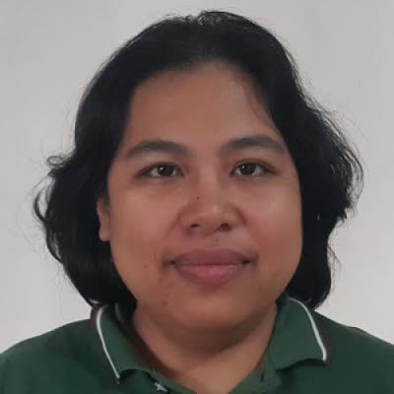
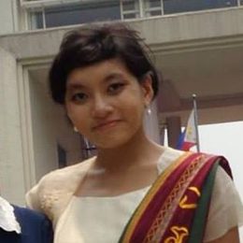
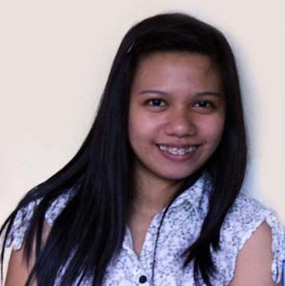
iOS STUDY GROUP
Twitter: @wwcodemanila
FB: fb.com/wwcodemanila
#WWCodeManila
#iOS #Swift
#StudyGroup

Slide 3
Ciela Salazar
iOS Developer
Sprim
Notes:
Please use only the three colors for the content.

Slide 4
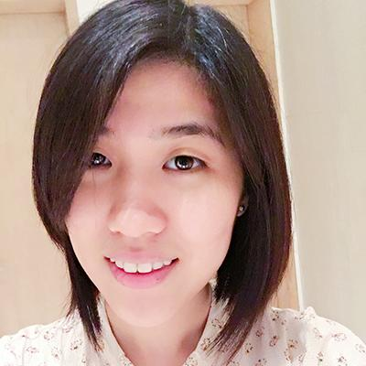
Steffi
iOS Developer
Deal Grocer
Notes:
Please use only the three colors for the content.

Slide 5
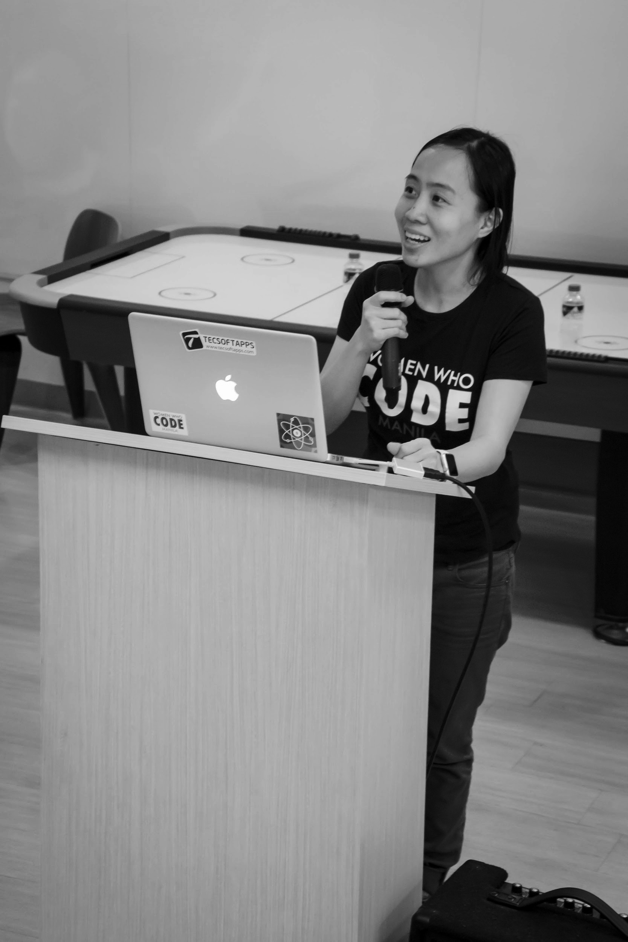

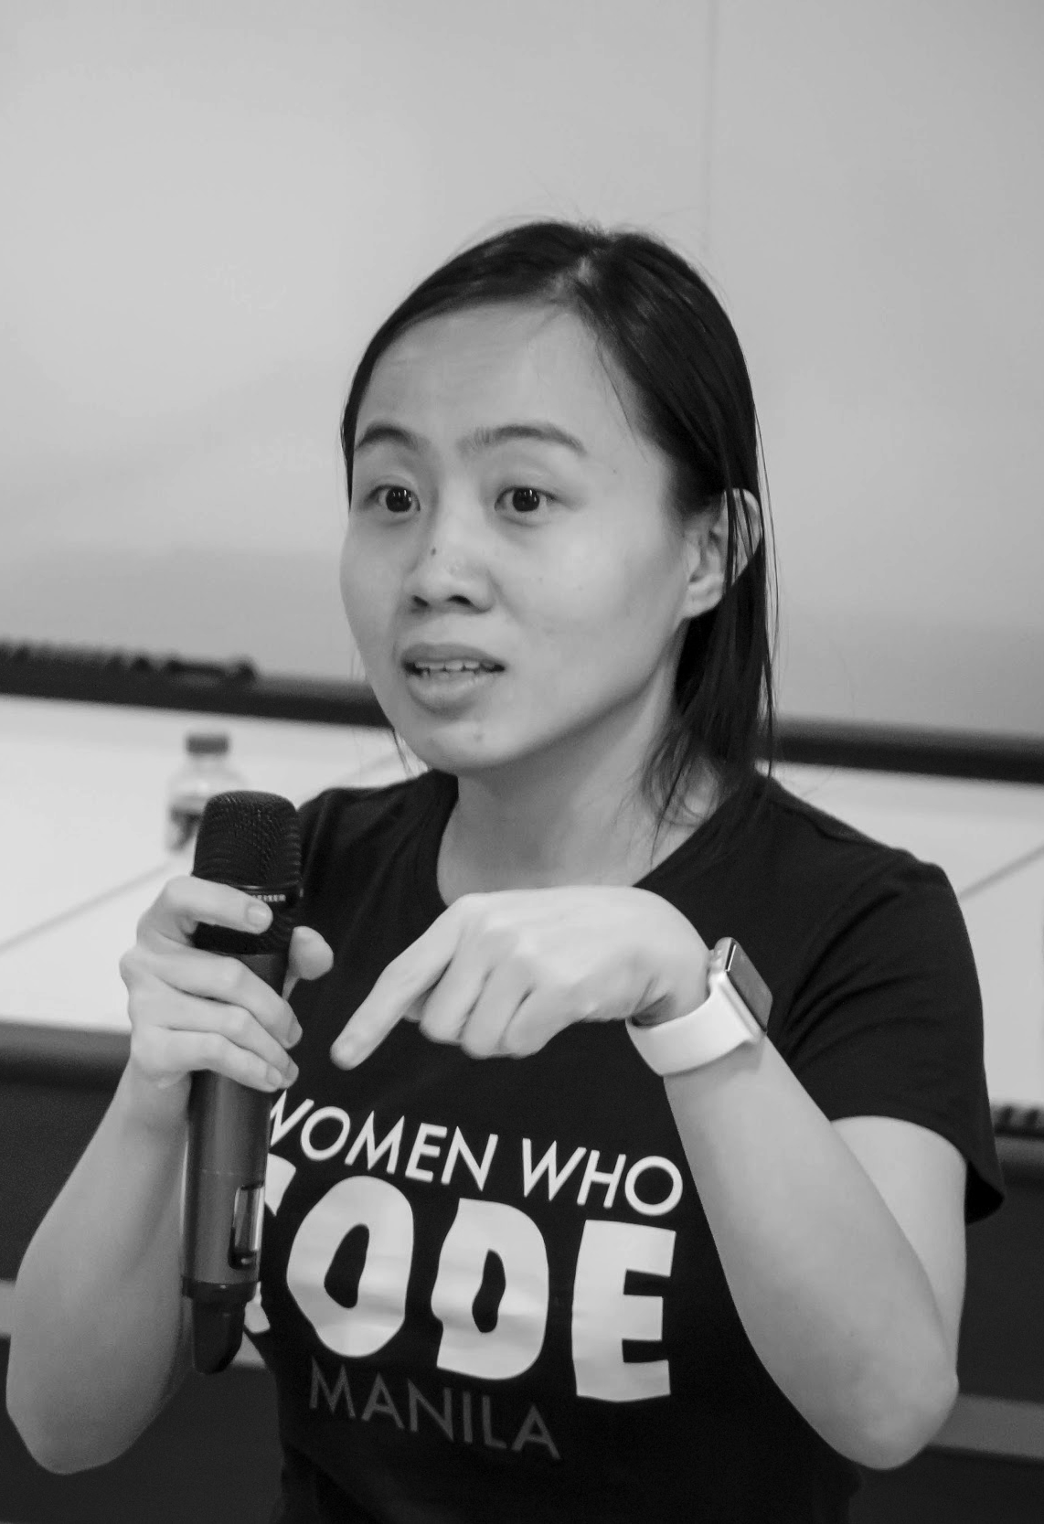
OUR MISSION
Inspiring women to excel in technology careers.

Slide 6
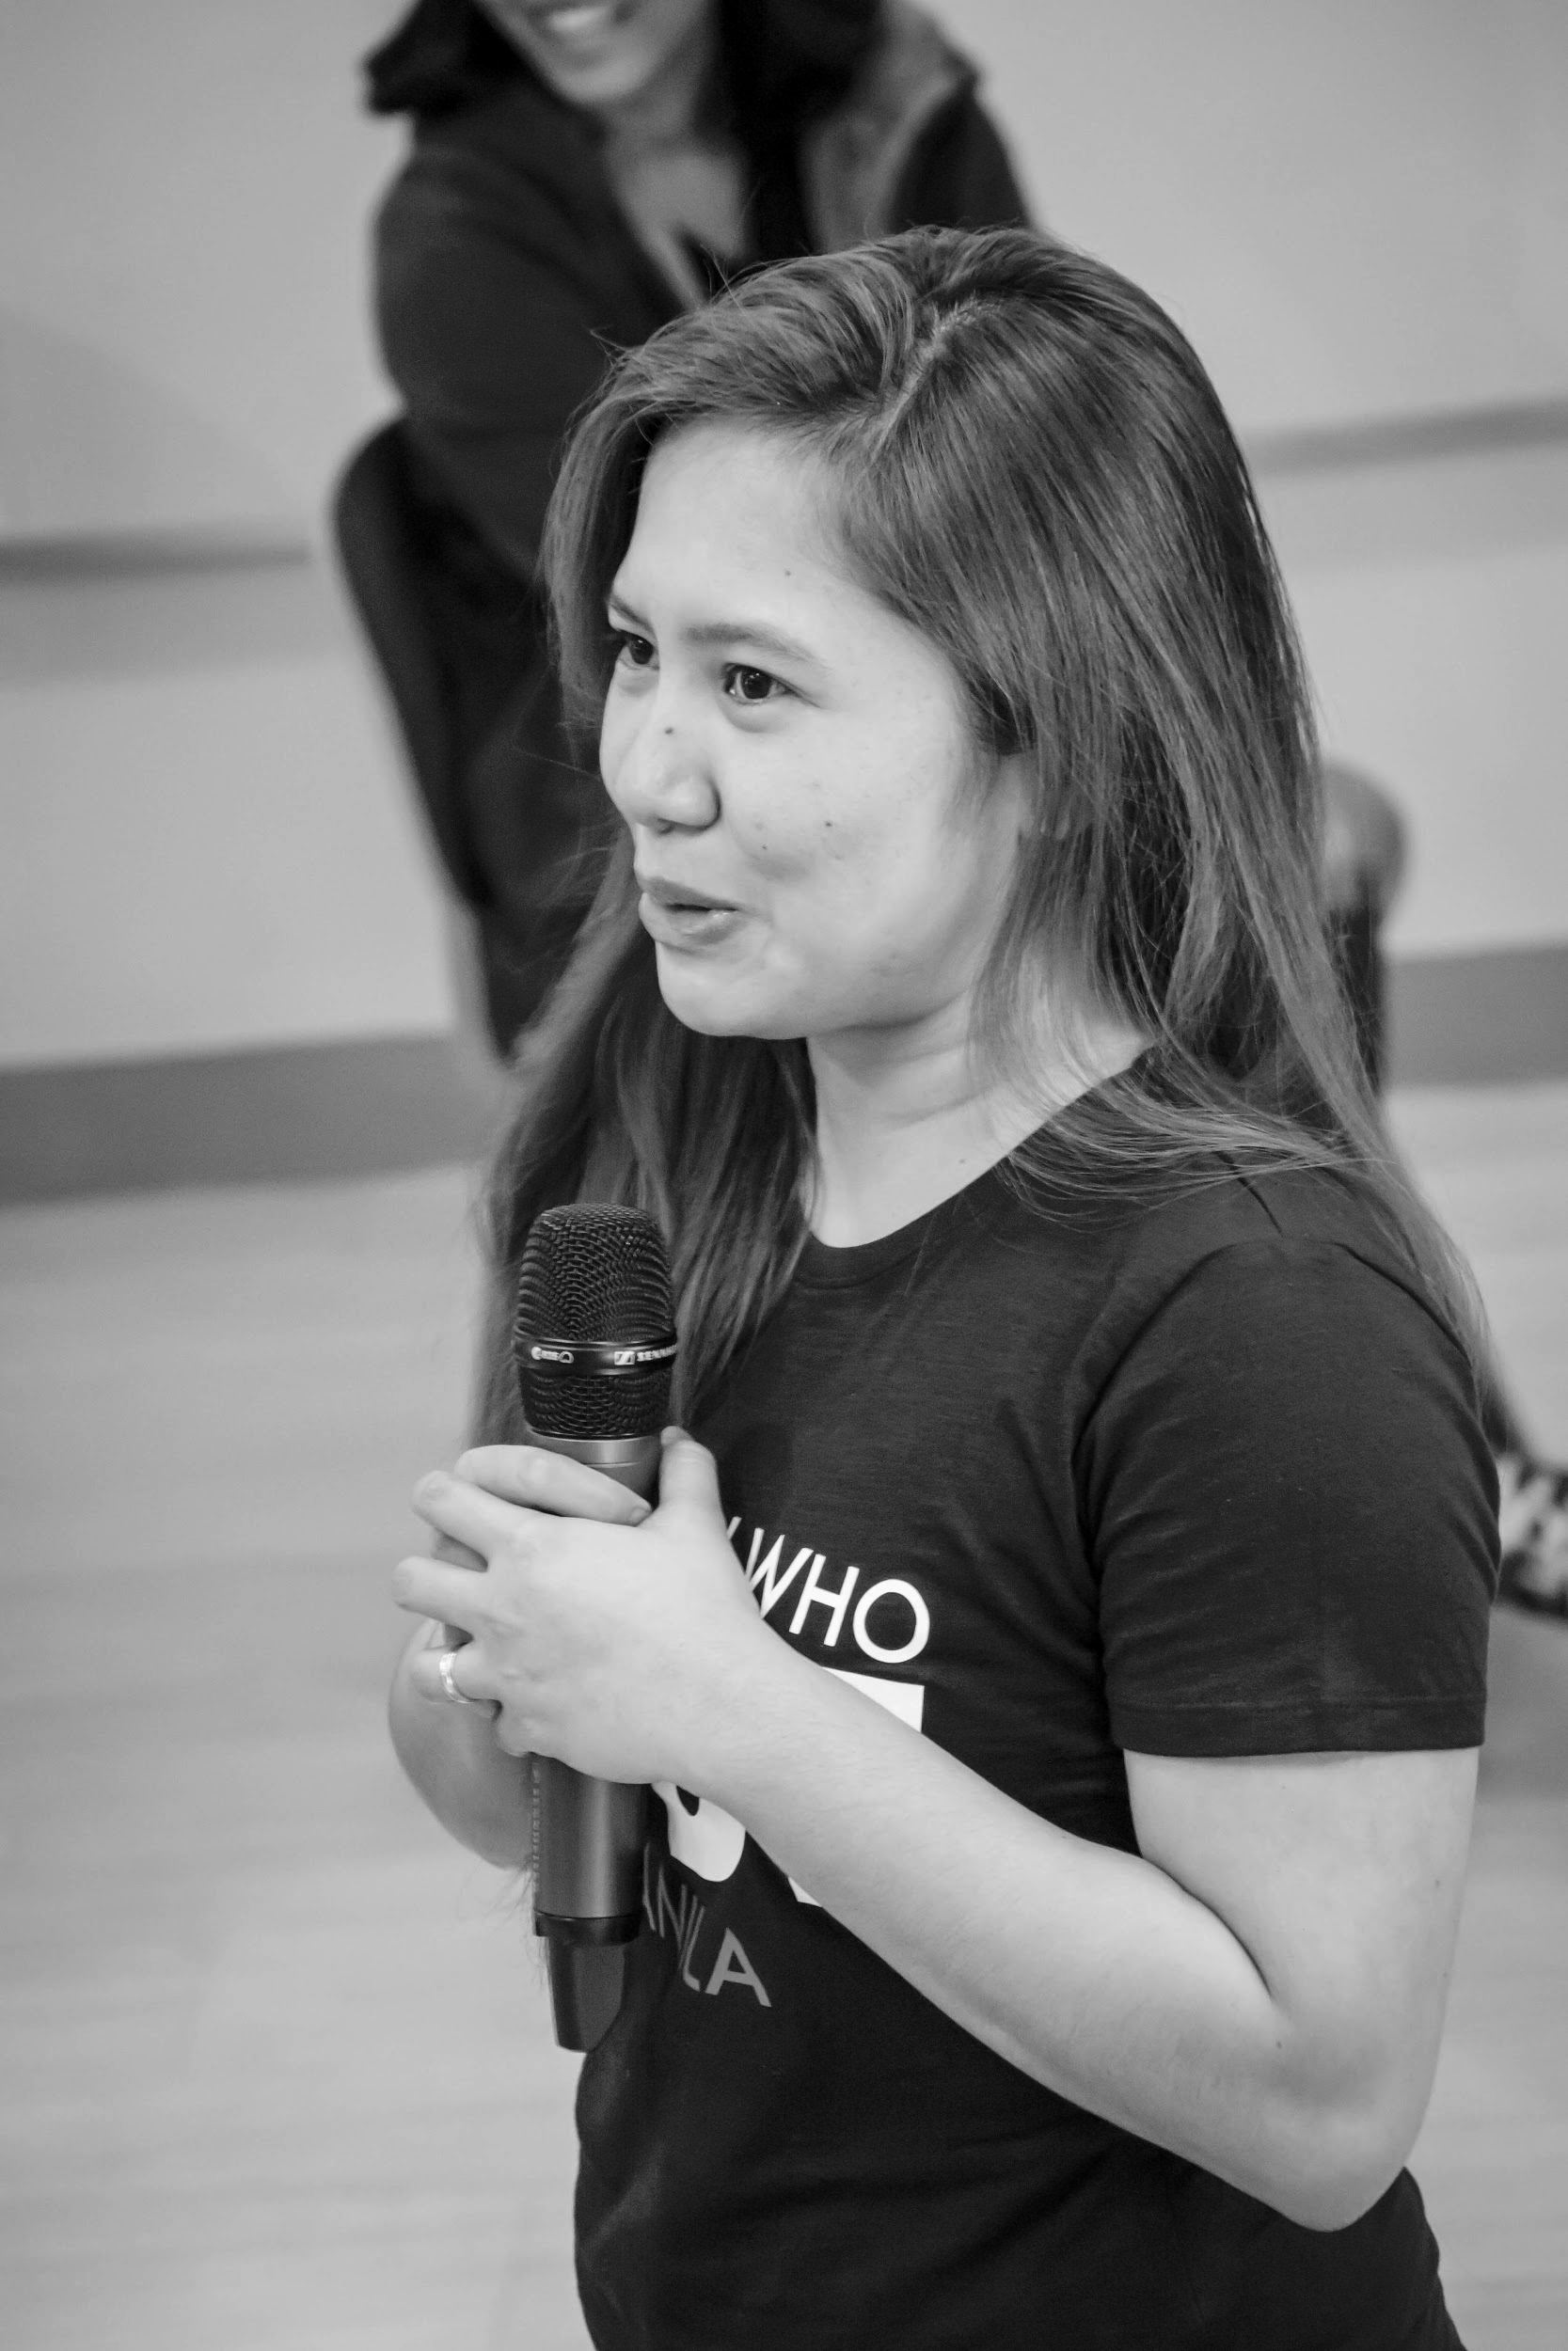
OUR VISION
A world where women are representative as technical executives, founders, VCs, board members and software engineers.

Slide 7
STUDY GROUP
Study groups are events where women can come together and help each other learn and understand a specific programming language, technology, or anything related to coding or engineering.

Slide 8
GUIDELINES
If you have a question, just ask
If you have an idea, share it
Make friends and learn from your study groupmates
Do not recruit or promote your business

Slide 9
New Member’s Introduction

Slide 10
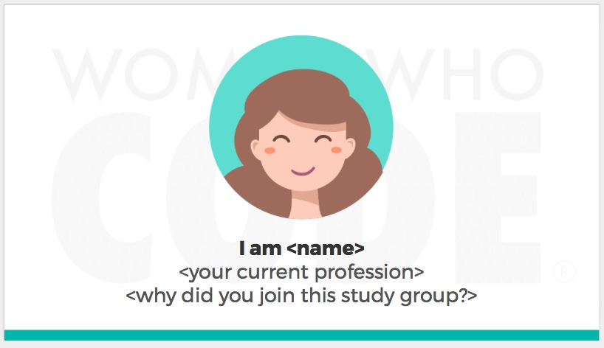
Notes:
Please use only the three colors for the content.

Slide 11
SHOW & TELL
Notes:
Please use only the three colors for the content.

Slide 12
TOPIC FOR TODAY
Notes:
Please use only the three colors for the content.

Slide 13
UITABLEVIEW
Notes:
Please use only the three colors for the content.

Slide 14
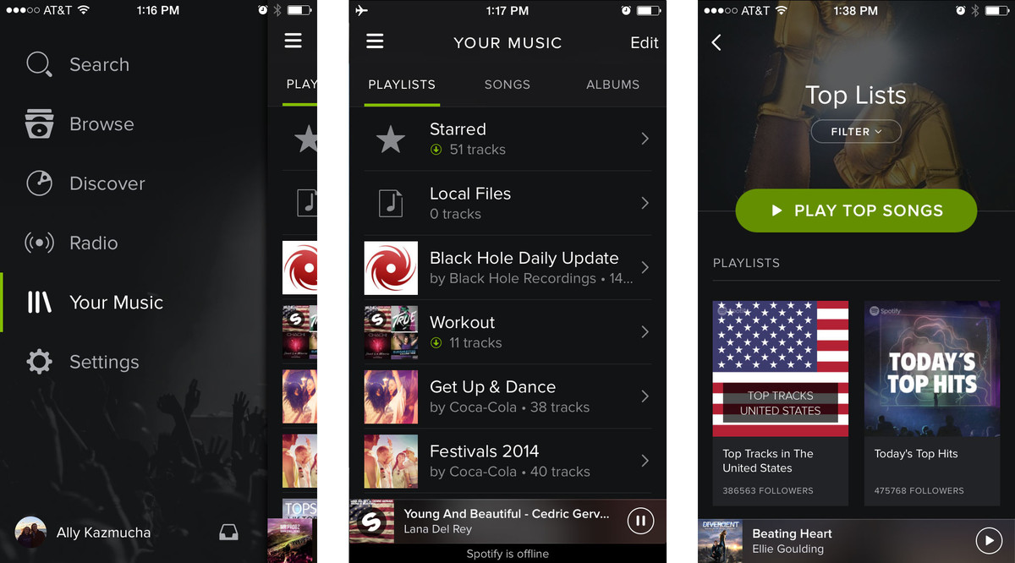

Slide 15
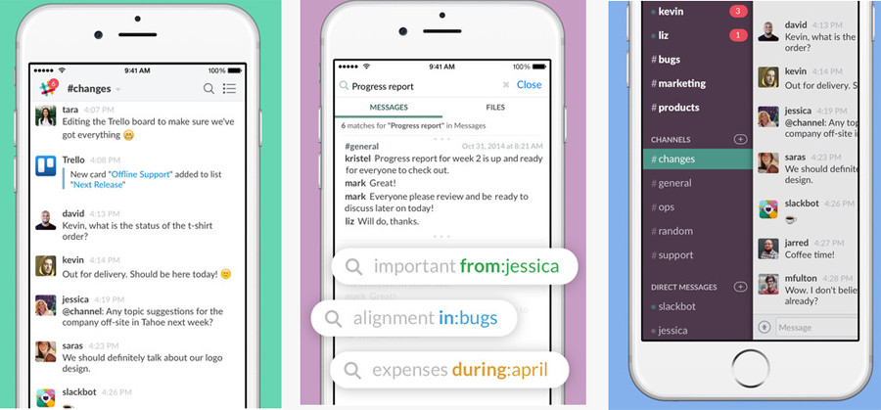

Slide 16
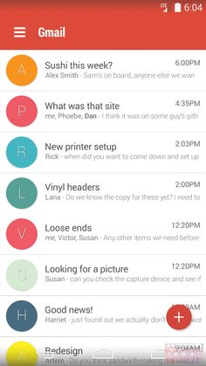
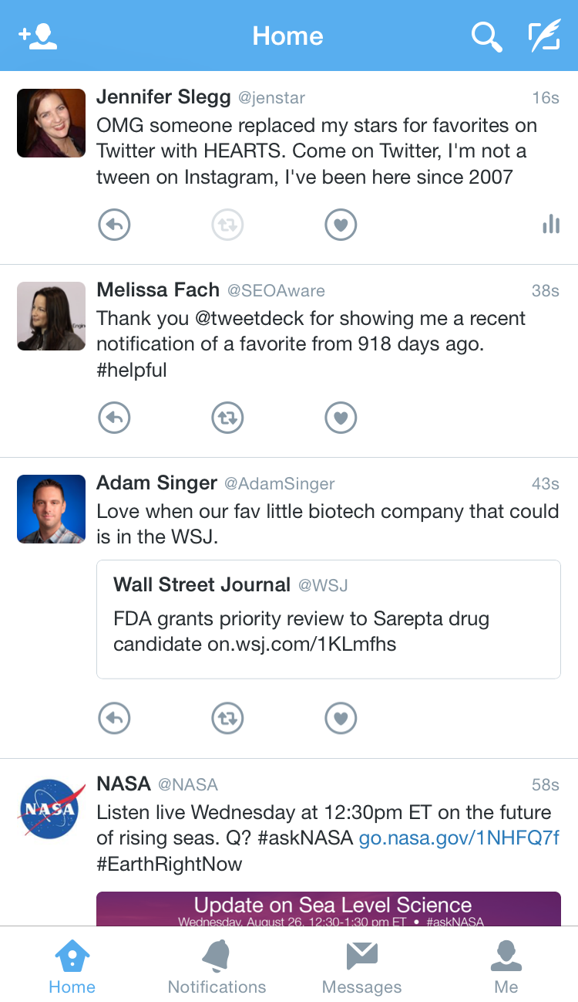

Slide 17
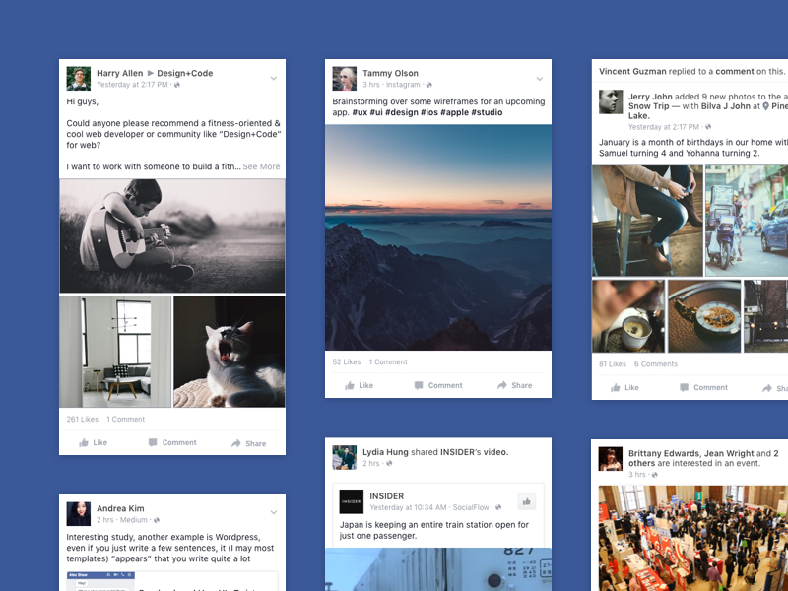

Slide 18
What do these apps have in common?
These have implemented a list for their core functionality
It can be achieved by using UITableView in your iOS app

Slide 19
What is UITableView?
A view that presents data using rows arranged in a single column.
The class that implements the UITableView must conform to the UITableViewDataSource protocol for its data source and the UITableViewDelegate protocol for its delegate
You can also use UITableView embedded in UITableViewController:
A controller object that manages a table view. (from Apple Documentation)

Slide 20
But wait! Protocol?!
A protocol defines a blueprint of methods, properties, and other requirements that suit a particular task or piece of functionality.
The protocol can then be adopted by a class, structure, or enumeration to provide an actual implementation of those requirements.
Any type that satisfies the requirements of a protocol is said to conform to that protocol.(from Apple documentation)
This is the delegate object.

Slide 21
What about Delegation?
design pattern that enables a class or structure to hand off (or delegate) some of its responsibilities to an instance of another type (from Apple Documentation)
Think of the relationship between the Protocol and the Delegate as a job contract.

Slide 22

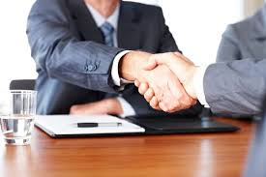


Slide 23
Why are these important to UITableView?
UITableView class implement Protocols and Delegate for it to work on an iOS App
These are also common in UICollectionView

Slide 24
Let’s add UITableView!
- Show a list of fruits and vegetables

Slide 25
What are Extensions?
- add new functionality to an existing class, structure, enumeration, or protocol type (from Apple Documentation)
- Smart Design Pattern to extend additional functionality without modifying existing functionality
- I’ll be using it to make code separated by logic

Slide 26
Partner/Group/Individual Exercise
Notes:
Please use only the three colors for the content.

Slide 27
Partner/Group/Individual Presentation
Notes:
Please use only the three colors for the content.

Slide 28
Assignment
Notes:
No required

Slide 29
Did you know?
You can customize a UITableViewCell by either:
creating a UITableViewCell Subclass
Create a Nib and load it as a custom UITableViewCell
You can add segues on tap of UITableViewCells to direct to different View Controllers
You can swipe to the left to delete or edit the cell that you choose. (Hint: It is also part of UITableView Protocol)
Use sections instead of rows to contain the data source
Remember: Try and Try until you succeed 👍

Slide 30
References
Notes:
Please use only the three colors for the content.

Slide 31
T.I.L.
SHARE IT!
In front!
On Twitter: @wwcodemanila
Or FB: fb.com/wwcodemanila
Don’t forget to tag WWCodeManila so we can retweet or share it.
Notes:
Please use only the three colors for the content.

Slide 32
Feedback Form
https://goo.gl/YzSqcS
Please don’t rate the event on meetup.
Not helpful. It is best to just tell your concerns via the feedback form. We are a building a community not a Yelp restaurant.
Notes:
Please use only the three colors for the content.

Slide 33
THANK YOU :)
Notes:
Please use only the three colors for the content.

